Slide 2
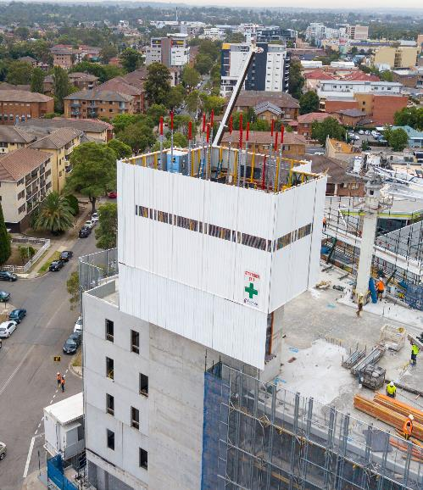
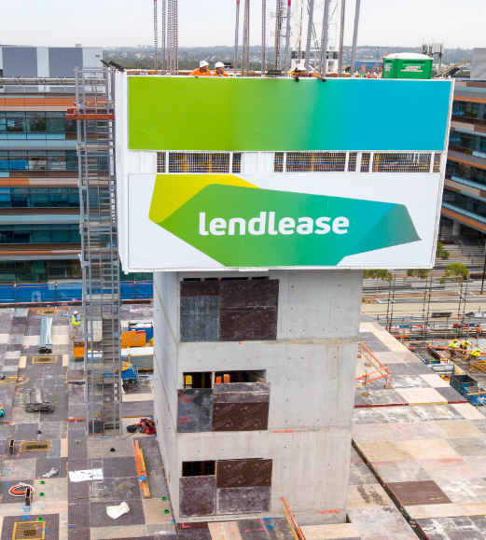
OVERVIEW ON FABQUIP’S JUMPFORM SYSTEM

Slide 3
OVERVIEW
1. INTRODUCTION TO THE JUMPFORM SYSTEM
2. DESIGN
3. CONSTRUCTION
4. ACCESS & EGRESS
5. CLIMBING PROCESS
6. CONCRETE PLACEMENT
7. DOCUMENTATION REQUIRED
8. SOME GLIMPSES OF FABQUIP

Slide 4
1. INTRODUCTION
FABQUIP CONSTRUCTION SYSTEMS WAS FOUNDED IN 1967 AND IS SERVING WITH ITS HIGHLY EFFICIENT SYSTEMS THROUGHOUT AUSTRALIA, SOUTH EAST ASIA AND THE MIDDLE EAST.
FABQUIP’S JUMPFORM IS FULLY MODULAR, SELF-CLIMBING FORMING SYSTEM FOR HIGH-RISE CONSTRUCTION.
THE MAJOR ADVANTAGES OF FABQUIP’S JUMPFORM ARE:
FASTER CONSTRUCTION CYCLES, GREATER ECONOMY AND HIGHER LEVEL OF SAFETY.
COMPLETELY FLEXIBLE SYSTEM CUSTOMIZED TO CLIENT SPECIFICATION.
ELIMINATES CRANAGE FOR LIFTING OF FORMWORK PANELS AND SCAFFOLD REQUIREMENTS.
AFTER INITIAL TRAINING, THE SYSTEM CAN BE OPERATED BY SEMI-SKILLED LABOUR.
WORK DECKS ARE INCLUDED IN DESIGN FOR MAXIMUM EFFICIENCY AND SAFETY.
COMPLETE INTEGRATED WALL SYSTEMS THAT ARE ASSEMBLED ACCURATELY ONLY ONCE, AT FOOTING LEVEL. (NO NEED FOR KICKER WALLS).
FORM DESIGN IS EASILY MODIFIED TO PROVIDE ARCHITECTURAL FEATURES AND TEXTURES.

Slide 5
2. DESIGN – GENERAL OVERVIEW OF JUMPFORM SYSTEM
There will be approx. 56 pours between Basement 3 & Level 52.
The Core consists of both Lift & Stair Shafts.
There will be the Temporary Jacking Columns and Bracing from Basement 3 to B1 Mezzanine.
The Hydraulic Climbing Jumpform System is supplied by Fabquip, and is operated by Contractor personnel.

Slide 6
GENERAL LAYOUT

Slide 7
2. DESIGN - LOADINGS AND WORKING SPACE
LOADINGS MAIN DECK & HANGING DECK – AS PER FABQUIP LOADING DECK LAYOUT DRAWING.
Main Deck Live : 100 kg per sq.metre
Main Deck Material Storage : 320 kg per sq.metre
Main Deck Concentrated : 230 kg
anging Deck Distributed : 120 kg per sq.metre
Hanging Deck Concentrated : 130 kg
WIND LOAD-JUMPFORM CLIMBING : Jumpform system is not to be climbed in winds exceeding 15 metres per second / 54 km’s per hour. Wind speed can be monitored via Tower Crane.

Slide 8
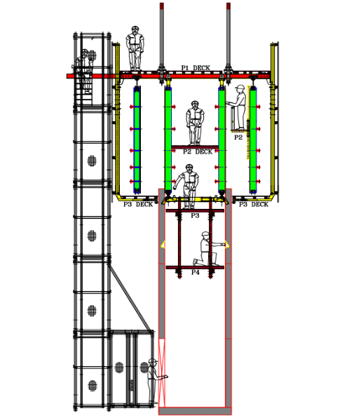
2. DESIGN - HEAD SPACE WITHIN JUMPFORM SYSTEM
P1 TOP DECK : No overhead restrictions.
P2 TEMPORARY HANGING WORK PLATFORM : Approx. 2.1 m to P1 Deck. P2 Hanging Work Platform to have Fabquip handrail system installed.
P3 INTERMEDIATE DECK : Min approx. 2.1 mm to P2 Deck.

Slide 9
3. CONSTRUCTION - SITE DELIVERY & SITE LAYDOWN AREA
Delivery trucks to park in project specific ‘Loading/Unloading areas’.
Equipment to be unloaded and delivered to the designated laydown areas.
Lifting operations to be conducted by project Crane Crew with assistance from Fabquip and/or contractor representative.

Slide 10
3.CONSTRUCTION - ERECTION & INITIAL CLIMB
1. Forms delivered to site and unloaded into lay-down area.
2. Pre-assemble internal Jumpform Boxes on site, in designated area.
3. Individual shutters to be installed into position, plumbed and secured using bracing.
Temporary working decks to be installed to internal side of box.
4. Install and position external form shutters and tie-off with Z-Bar through to internal box.
5. Construct temporary working deck around perimeter of Jumpform system.

Slide 11
3.CONSTRUCTION - ERECTION & INITIAL CLIMB
…….CONTINUED
6. Install gridwork member. Individual members to be craned & installed 1 at a time.
Workers to work from working decks.
7. System Hydraulics to be installed as per Fabquip hydraulics drawing.
8. Construct top deck P1. Works to be conducted from grid section with existing internal
and perimeter working decks providing fall protection.
9. Once P1 top deck has been completed, temporary handrails to be installed to perimeter
of P1 top deck.
10. Heavy steel members will require use of tower crane.

Slide 12
3.CONSTRUCTION – ERECTION & INITIAL CLIMB
…….CONTINUED
11. Install & secure scaffold hangers to structure. Workers to work from top deck P1 &
temporary perimeter working decks.
12. Install cladding timbers to scaffold hangers. Workers to work from temporary
perimeter working decks.
13. Fabquip to conduct inspection and provide “Initial Sign-Off”.
14. Rolling shutters to be opened & secured, and system hand over for installation of
reo and services.
15. Rolling shutters to be closed and secured ready for concrete placement upon
contractor authorisation.
16. Once concrete has achieved correct strength, shutters are opened, penetration
formwork is stripped and removed, & penetration openings secured.

Slide 13
3.CONSTRUCTION - ERECTION & INITIAL CLIMB
…….CONTINUED
17. System Hydraulics to be charged and inspected by Fabquip Technician.
18. System to be cracked and climbed approx. 1.5 m to allow room to install Shear Key,
P3 deck, and perimeter cladding.
19. Shear Key Beams to be installed to internal box.
20. Install P3 deck to internal box.
21. Install Scaffold Feet to existing Scaffold Hanger to provide supporting structure for
external P3 deck.
22. Install Lobby Beams into position.
23. Construct P3 perimeter deck and secure to Scaffold Feet.

Slide 14
3.CONSTRUCTION - ERECTION & INITIAL CLIMB
…….CONTINUED
24. Install external hanging stair modules x 2 to Jumpform System. Stair modules to be
craned into position and secured.
25. Sequentially, install cladding section to perimeter of Jumpform System. Workers
securing cladding to be working from behind handrails on P1 deck & from P3 deck –
P3 deck will be approx. 975 mm above ground level at this stage.
26. Once cladding sections have been fully installed and secured, system is climbed to the next pour
level.
27. Temporary perimeter working decks to be removed.
28. Fabquip to conduct final inspection and conduct system commissioning process.

Slide 15
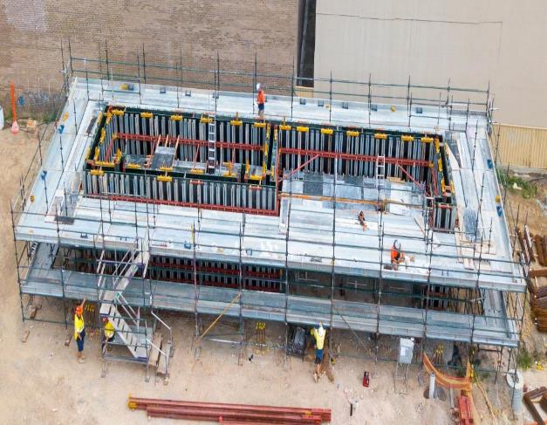
3.CONSTRUCTION – TEMPORARY WORKING DECK

Slide 16
Gridwork, Hydraulics and Top Deck

Slide 17
4. ACCESS & EGRESS – ACCESS TO & FROM JUMPFORM
Access stair loading limits = (250 kg) per flight.
The hanging stair is of a modular construction and modules come in 1.5 & 3 m sections. These sections can be added to the base of each stair module, as required, to create a drop off platform through door opening and exit on concrete slab.
Access to and from individual Jumpform cells, and from trailing deck levels, is via the access ladders and access hatch system for each cell.

Slide 18
4. ACCESS & EGRESS – HANGING STAIR ACCESS POINTS TO JUMPFORM
ACCESS STAIR MODULE -SECTION

Slide 19
4. EMERGENCY EVACUATION PROCEDURE
In the event of an emergency, workers are to leave the Jumpform System using either of the two primary access stairs, or secondary access points, at trailing deck levels.
Workers are to follow the contractors site specific emergency protocol as per the site emergency plan.

Slide 20
4. EMERGECNCY RESCUE
IN THE EVENT THAT A PERSON IS REQUIRED TO BE RESCUED OR RETRIEVED FROM THE JUMPFORM SYSTEM :
Nurse call system to be activated and First Aider to attend scene for assessment and/or treatment to be provided as required.
RESCUE FROM WITHIN A CELL : Retrieval to be conducted by qualified site personnel, or by emergency services, by use of tripod and positioned on top deck over access hatch points, or new access points can be cut into top deck as required.
RESCUE FROM P3 DECK : Person to be removed from P3 deck via the Emergency Doors located adjacent to the P3. Removal and lowering of personnel can be conducted by use of First Aid Cage suspended from Davit Arm, or site Tower Crane.
RESCUE FROM TOP DECK USING CRANE : Injured person to be lowered using craneable First Aid Cage.
RESCUE FROM TOP DECK USING DAVIT ARM : Injured person to be lowered to designated point (eg. top deck) by qualified site personnel or emergency services.
Jumpform subcontractor personnel to be trained in tripod and davit arm rescue.

Slide 21
4.EMERGECNCY RESCUE - RESCUE POINT LOCATIONS
EMERGENCY EXIT DOOR

Slide 22
3. EXCLUSION ZONES
During Jumpform operations, exclusion zones are to be established and relocated progressively as per sequence of task.
Physical barriers with the assistance of warning signage and/or spotters to be used around work areas where segregation from other personnel and/or plant is required.
Positive communications to be in place where spotters are in use. Positive communication can be via verbal, visual or 2-way radio communications.
Prior to commencing the Jumpform climbing process, an exclusion zone must be installed to the top deck/level directly below the sections that are being climbed – no unauthorised personnel are to be positioned within any exclusion zone.

Slide 23
4. CONCRETE PLACEMENT
PRIOR TO COMMENCING CONCRETE PLACEMENT :
All ITPS and Certification documentation to be completed and signed-off by contractor.
Management to manage concrete subcontractor works, and communicate approved pour rates as documented in Fabquip design drawings.
Contractor to provide personnel (Pour Monitors) to monitor concrete pour within jumpform system.
Positive communication to be established between work crews (Contractor and Sub-contractor) and Pour Monitors.

Slide 24
5. CLIMBING PROCESS

Slide 25
5. JUMPFORM CLIMBING PROCESS - PRE CLIMB
PRIOR TO THE JUMPFORM CLIMBING PROCESS COMMENCING :
Contractor to complete the Pre-Climb Checklist.
Main contractor to confirm to contractor that desired concrete strength has been achieved.
Contractor to notify other trades of impending climb.
Contractor to secure access onto Jumpform – no unauthorised entry.
Contractor to install exclusion zones below climbing area.
Contractor personnel to climb Jumpform System as per Fabquip Climbing & Operations manual.

Slide 26
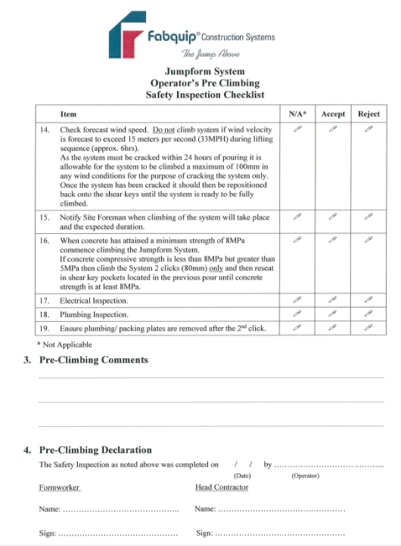

Slide 27
5. JUMPFORM CLIMBING PROCESS - POST CLIMB
ONCE THE CLIMBING PROCESS HAS BEEN COMPETED :
Contractor to complete Post Climb Checklist.
Exclusion zones to be removed once works have been fully completed.

Slide 29
7. DOCUMENTATION REQUIRED
Approved Shop Drawings and Engineer Certifications.
Fabquip Assembly & Operating Methodology.
SWMS & SOP’s.
Approved Pre and Post Climb Checklists.

Slide 30
8. SOME GLIMPSES OF FABQUIP

Slide 31
COMPLETE SYSTEM ARIAL VIEW

Slide 32
Extra external decks for patching.

Slide 33
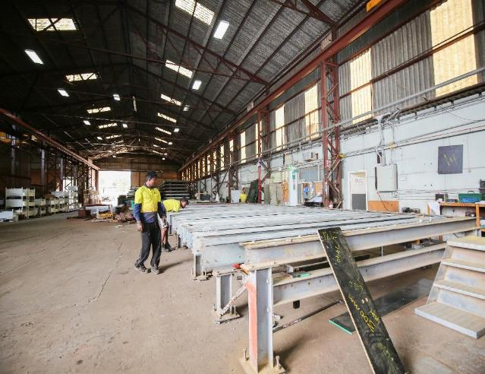
MANUFACTURING PROCESS

Slide 34
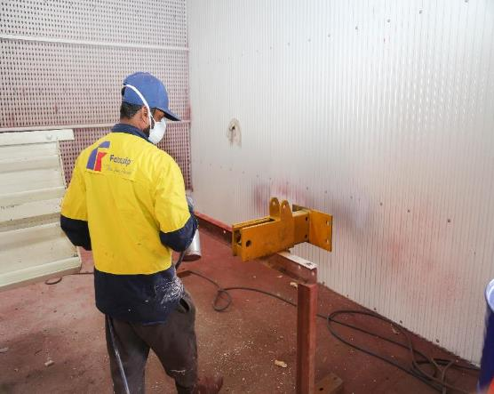

Slide 35
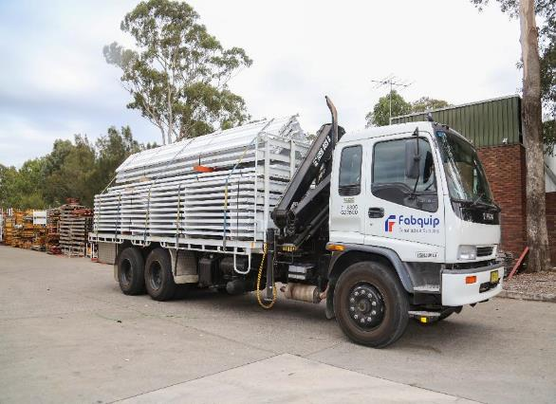
TRANSPORTATION

Slide 36
PAST PROJECTS

Slide 42
ANY QUESTIONS???
CONTACT DETAILS
FABQUIP CONSTRUCTION SYSTEMS
36-42 FITZPATRICK ST, REVESBY NSW 2212, AUSTRALIA
PHONE: +61 02 97744099
FAX: +61 02 97742473
EMAIL: info@fabquip.com

